Slide 1
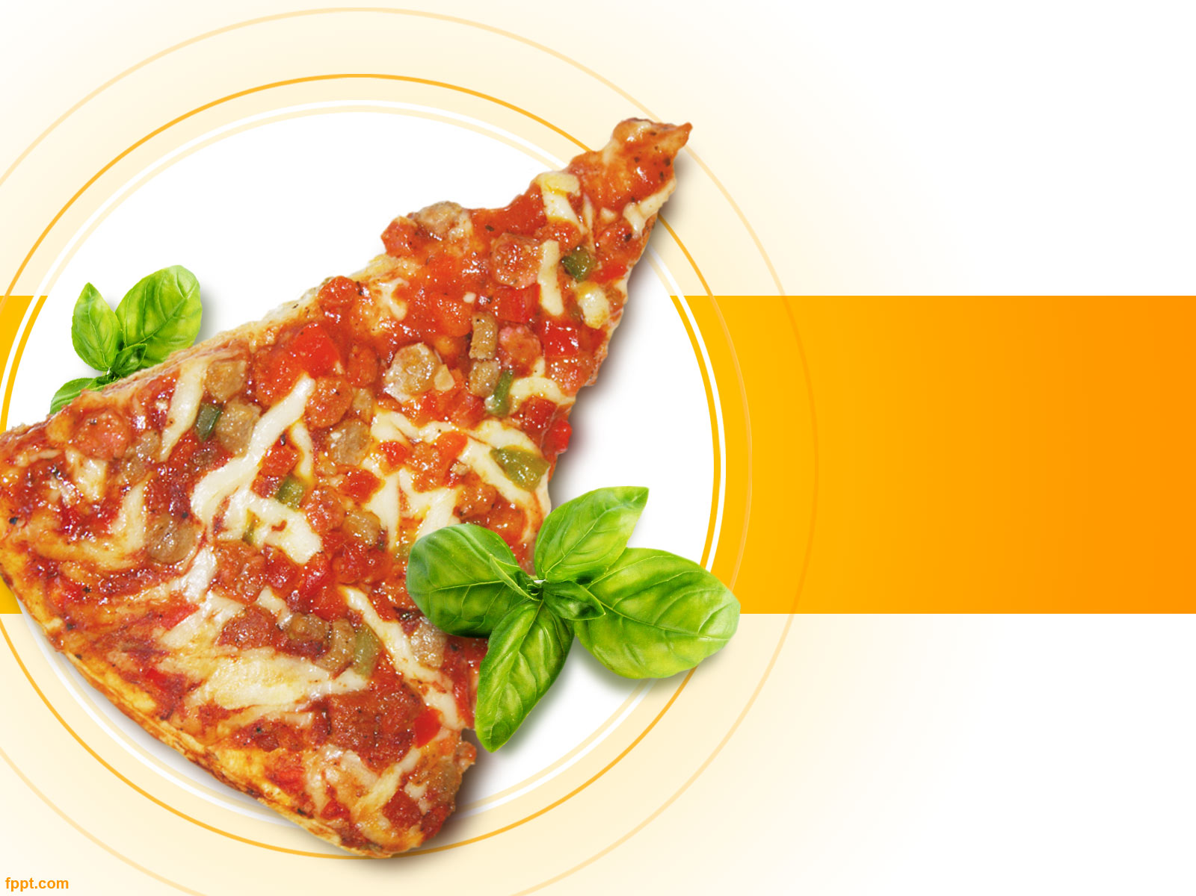
Pizza Sales Analysis using SQL

Slide 2
INDEX
Introduction
Objective
Dataset Explanation
Dataset Preview
SQL queries

Slide 3

Introduction
The Pizza Sales Database project is designed to track and analyze pizza sales data. The dataset contains valuable information about each pizza sale, including specific details about the pizza itself, Total orders, and most demand pizza.
By organizing this data in a structured way, businesses can better understand customer preferences, order patterns, and financial performance, helping in decision-making processes.

Slide 4
Objective
The objective of this project is to build and maintain a comprehensive Pizza Sales Database that enables efficient querying and analysis of the following:
Tracking Orders: Understand the volume and type of pizzas ordered over Month, Day.
Sales Analysis: Calculate total sales, unit prices, and revenue based on the quantity of pizzas sold.
Inventory Insights: Analyze which pizza sizes, categories, and ingredients are most popular.
Time-Based Analysis: Understand peak order month and dates, enabling businesses to optimize delivery and staffing.
Customer Preferences: Gain insights into the most popular pizza names and categories to enhance menu offerings.

Slide 5
Dataset Explanation
Dataset contains 48620 Rows and 12 columns.
Pizza id
Order id
Pizza name id
Quantity
Order date
Order time
Unit price
Total price
Pizza size
Pizza category
Pizza ingredients
Pizza Name

Slide 6
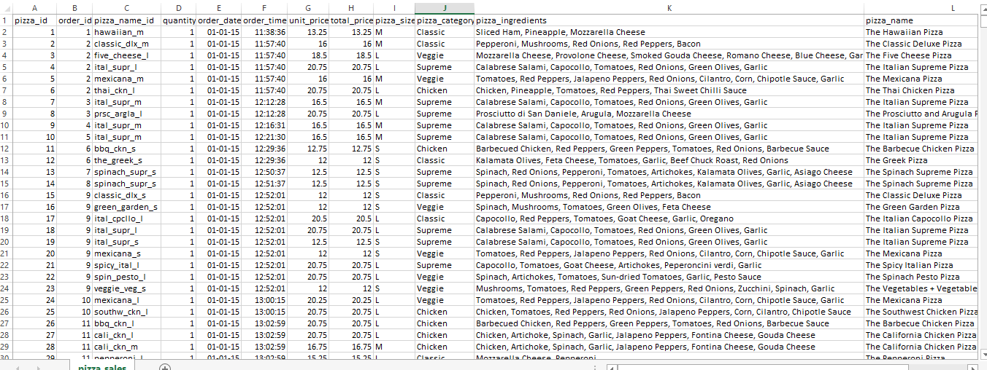
Dataset Preview

Slide 7
SQL Queries
View Dataset
Total Revenue
Average price order per order id
Total Pizza Sold
Total Orders
Average Pizza per order
Total pizza order per month
Total pizza order per Size
Total Pizza order per Day
Which pizza sold most

Slide 8
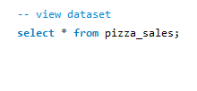
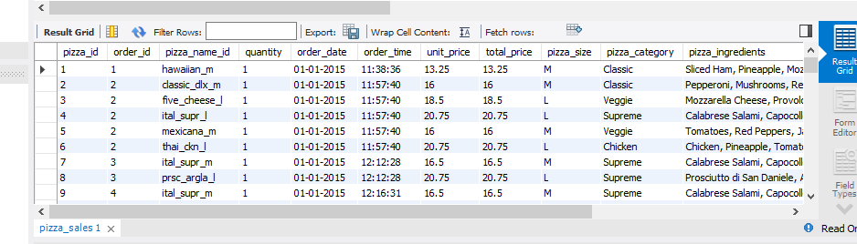
View dataset

Slide 9
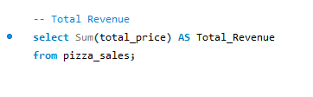
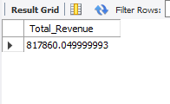
Total Revenue

Slide 10
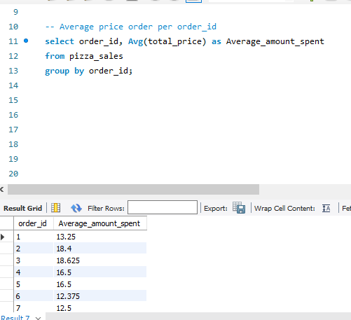
Average price order per order_id

Slide 11
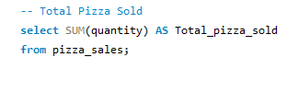

Total Pizza Sold

Slide 12
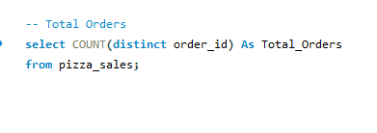
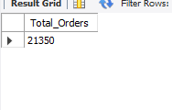
Total Orders

Slide 13
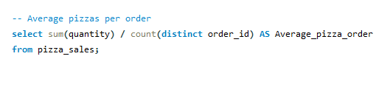
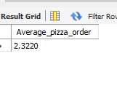
Average Pizza per order

Slide 14
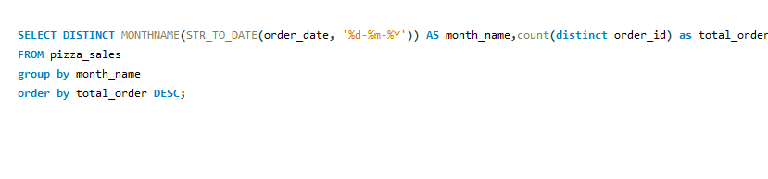
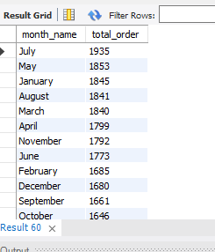
Total pizza order per month

Slide 15
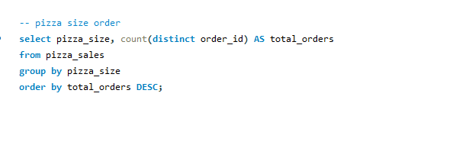
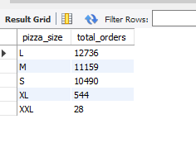
Total pizza order per size

Slide 16
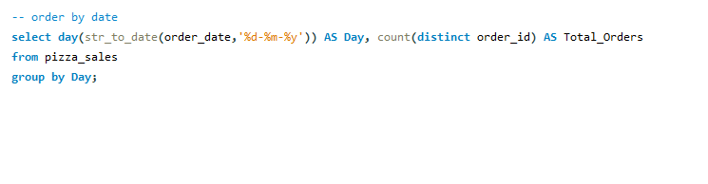
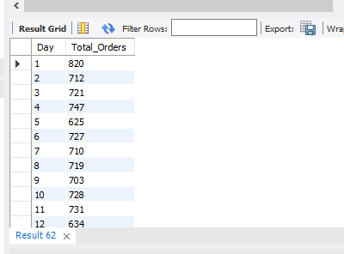
Total pizza order per day

Slide 17
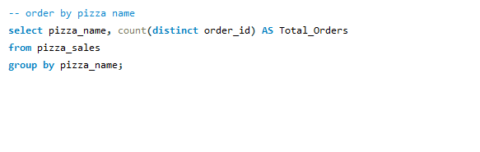
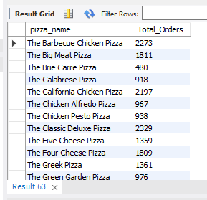
Which pizza sold most

